Slide 1
Web Modernization Program
Feb 23, 2018
WebRedesignTeam@uta.edu
Notes:
[Allow 5 minutes for new zoom users to setup]
Volume/mic
Review virtual meeting etiquette: start muted to avoid accidental noise/disruptions; please post questions to chat. We will have Q&A at end.
Meeting to be recorded, slides posted to website.
Explain why Daniel is speaking: Daniel and Claire are the primary communicators on behalf of the WMP. Key leadership such as the SC and program manager remain the same.

Slide 2
Objectives
Provide status updates
Set expectations for the coming months
Collect feedback
Understand involvement needed

Slide 3
Meetings
Monthly meetings with POC’s
Project updates, opportunities for feedback
Format, time, frequency

Slide 4
Project Advocates
Please email WebRedesignTeam@uta.edu with the senior-level project advocates from your college or department.
Project Advocates should..
Project Advocates Decision makers
understand marketing needs & target audiences
be an effective change agent
Project POCs High project engagement; activity agent
be committed to removing obstacles
be a decision-maker within the college
Web Captains Content owner/site maintenance. May also be technical resource.
be at a senior leadership level within the college
POCs and Project Advocates may be the same individual.

Slide 5
Sprint Updates
Web teams are making updates to:
New Maverick Orientation
International students
Limited scope, but measurable impact
These “sprint” projects should be completed by April
Notes:
Short-term updates to targeted areas identified as important to Fall 2018 enrollment & retention.
Orientation & International websites.
NEXT: Procurement update (Mai)

Slide 6
Phase 1: Discovery
Discovery
2. Architecture & Design
3. Targeted Content Migration
4. …
First engagement with implementation partner
Focus groups with campus departments
Will be scheduled once contract is signed
Notes:
Not to be confused with Journey mapping

Slide 7
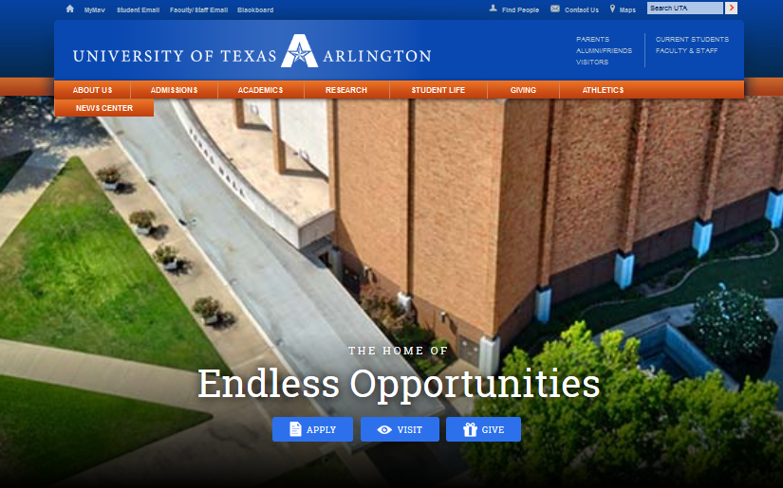
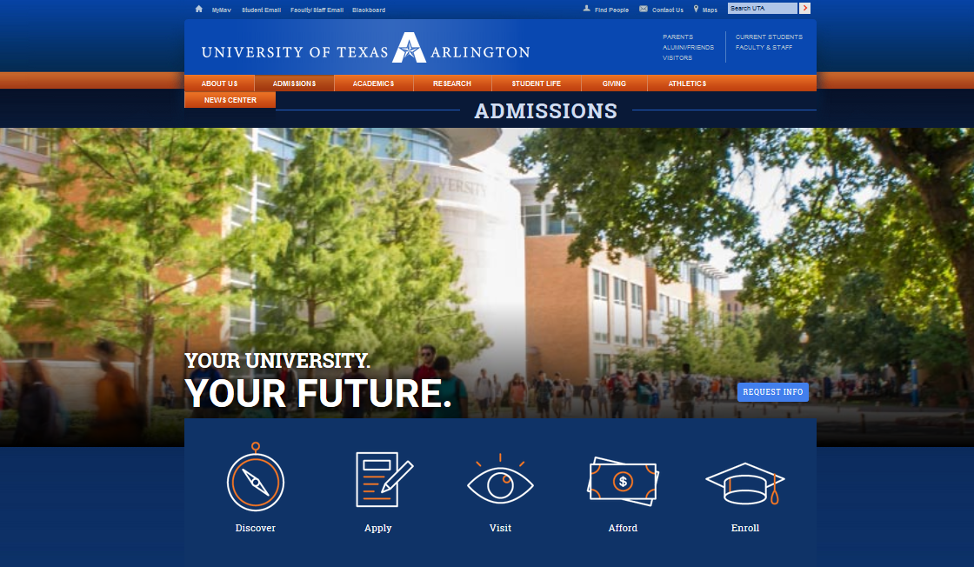
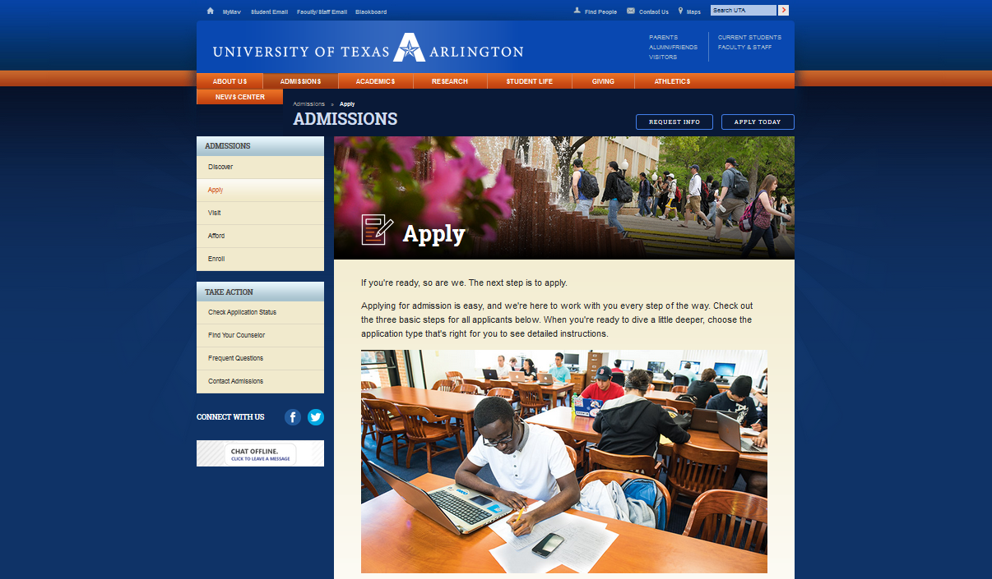
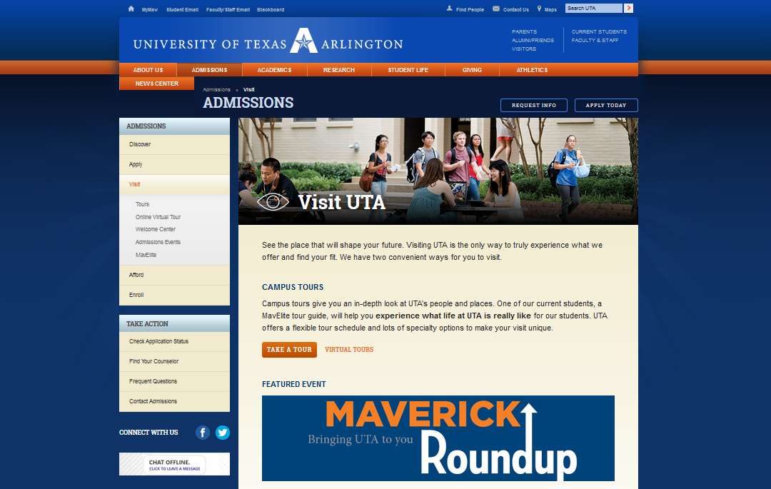
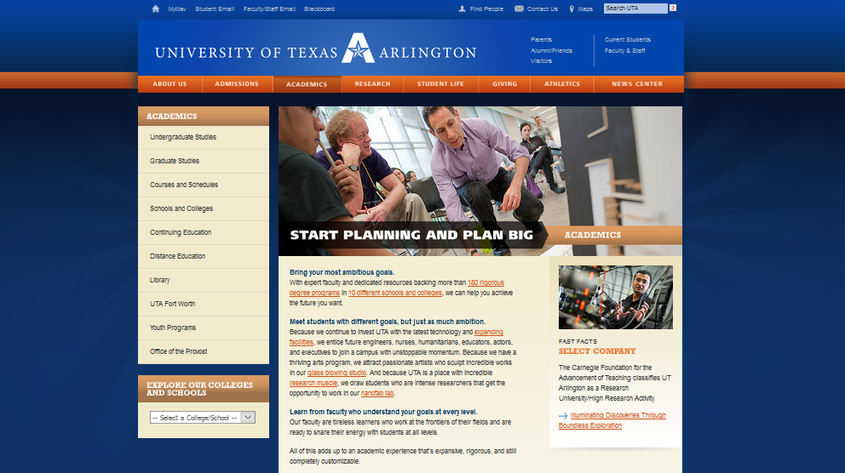
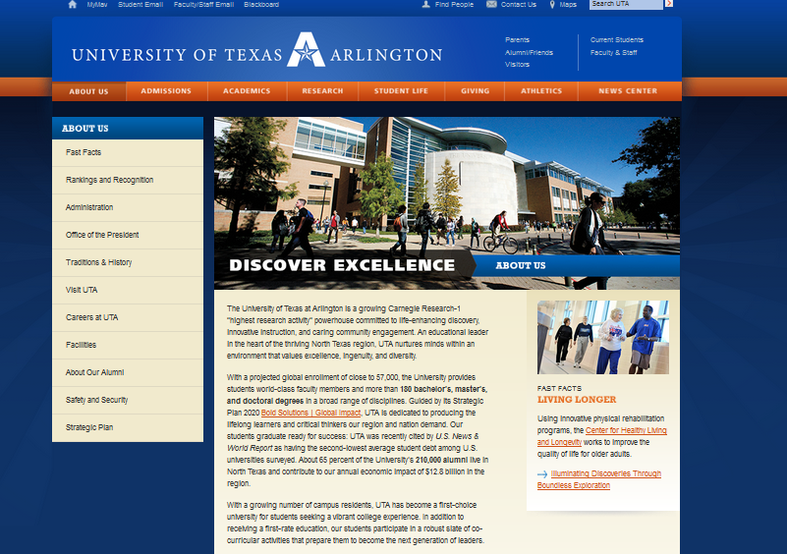
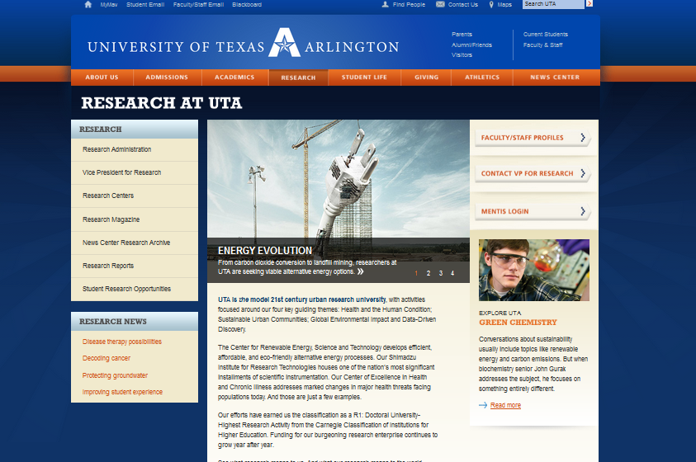
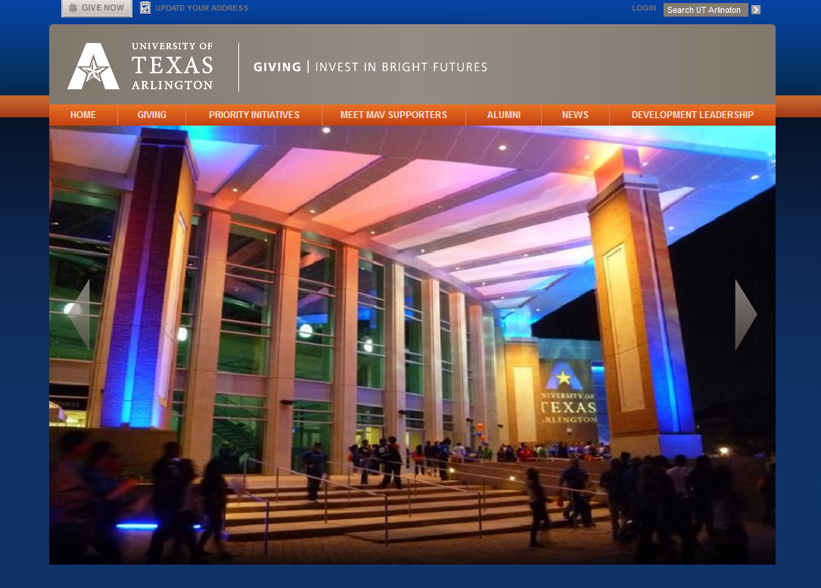
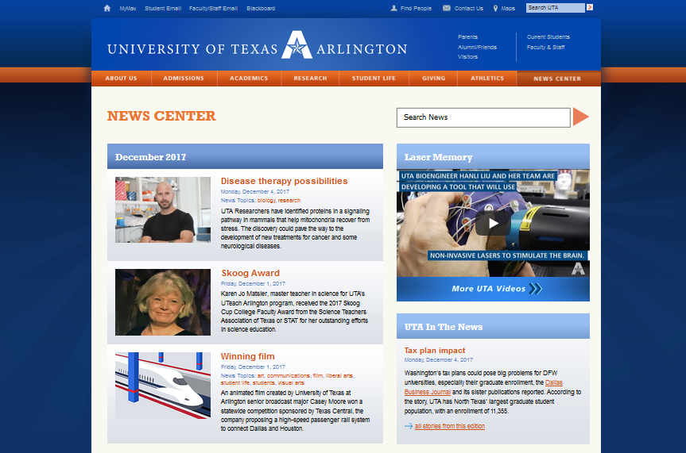
Unique Landing Pages
The pages listed below are included in the SOW
University Homepage
Admissions
Apply Now
Visit
Academics
Student Life
About Us
Research
Giving
News Center
Notes:
Some of the design stage deliverables.
We have tentative idea of where we are going, the overall direction is important and that is what is laid out in the SOW along with what is needed to be achieved
Reminder that not all UTA websites/webpages will go to Sitecore. Only the public-facing ones will be hosted in Sitecore.

Slide 8
Training & Support
OIT & UComm hiring additional resources
Improving collaboration and issue management
Notes:
NEXT: Business Affairs training and support (current and future) (Lee)
NEXT NEXT: Cascade Server Upgrade (Deepika)

Slide 9
Review
Continue site maintenance / cleanup
Questions?
Notes:
Continue reviewing your pages periodically in SiteImprove
Continue to correct your links and misspellings
Start to have discussions about how you think people end up on your pages and what questions they’re looking to answer – don’t look at your pages while you do this exercise. Then, look at your pages and see if these answers are proximately displayed and if not, how many clicks does it take to find them. Make notes.

