Slide 1
Web Modernization Program
Dec. 7, 2017
WebResdesignTeam@uta.edu
Notes:
Contracts will impact how we utilize the product and the life of how we implement
Contract needs to be strict enough to hold the implementation partner accountable by flexible enough for us to make adjustments
Ex. Building a home, you know what you want going in, but you want your contract to be flexible enough for you to make changes without costing you a fortune.

Slide 2
Key Objectives
Provide status updates on Project
Set expectation for the coming months
Collect feedback on the design
Understand involvement needed

Slide 3
Project Deployment
Phase I
Phase II
Phase III
Redesign using the current tool:
The main UTA webpage
A few other key pages
Vendor Selection:
Product, hosting, and implementation partners selected.
Expected to be completed in January
Implementation Partner:
Selected implementation partner.
Gather feedback from departments and colleges
Complete
1 Month
9 Months

Slide 4
Project Status Updates
The 3 updates provided below are interrelated and interdependent
Product
Sitecore has been selected as the University-wide content management system and will replace our current management system, Hannon Hill’s Cascade Server.
Contracts
Implementation
Contract negotiations with the Implementation partner are expected to be completed in January.
Contract negotiations with an implementation partner and still in progress. The Executive Committee has agreed on a scope for the implementation partner which includes unique landing pages and templates.
(Detail for the unique landing pages and templates is included on the following slide.)

Slide 5
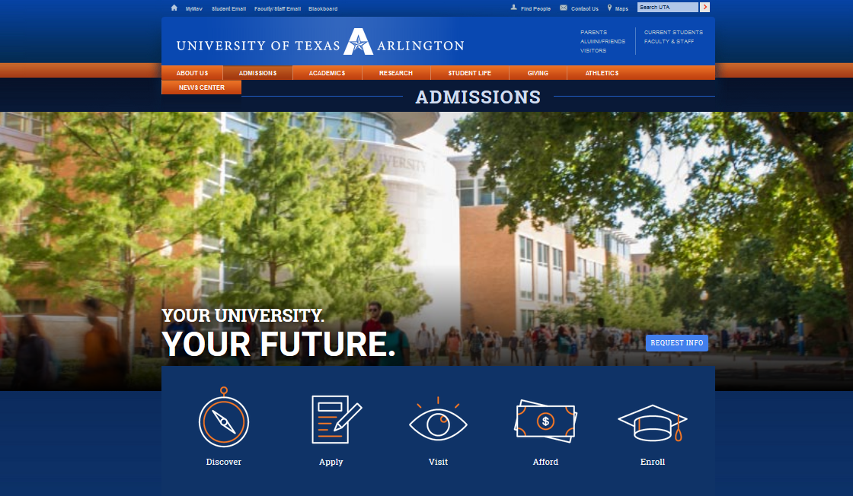
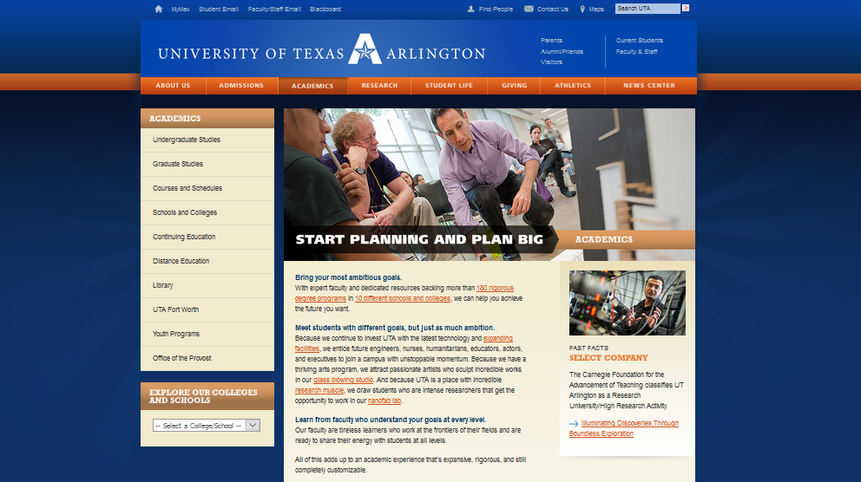
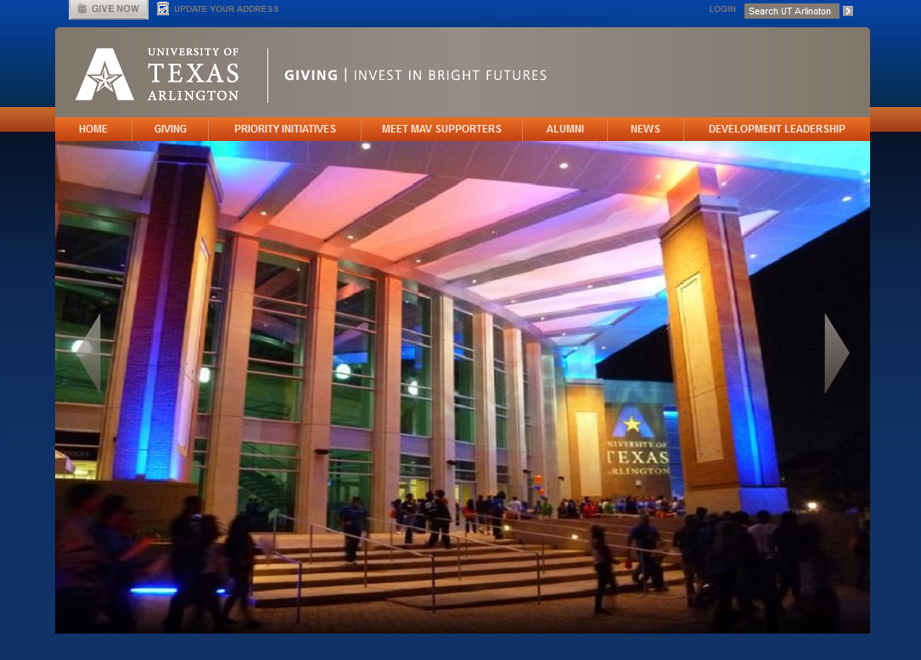
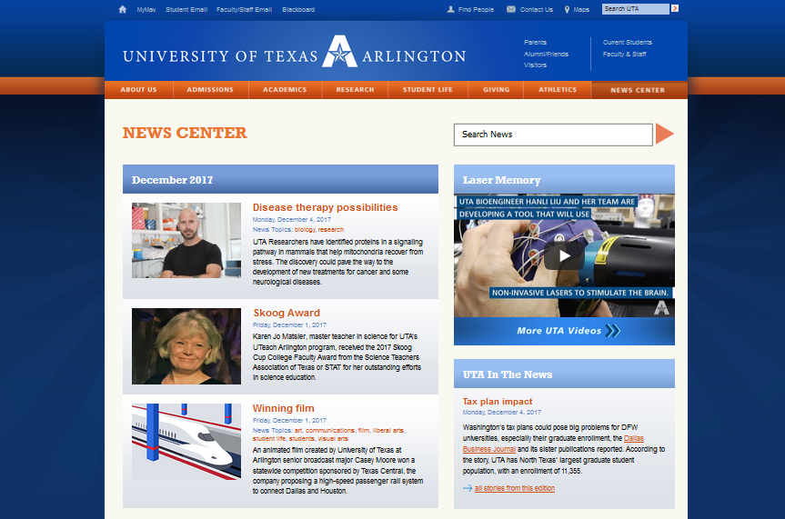
Unique Landing Pages
The pages listed below are included in the SOW
University Homepage
Admissions
Apply Now
Visit
Academics
Student Life
About Us
Research
Giving
News Center
Notes:
We have tentative idea of where we are going, the overall direction is important and that is what is laid out in the SOW along with what is needed to be achieved

Slide 6
Templates Detailed
The templates listed below are included in the SOW.
1
Individual Colleges & Schools
2
optimization
Department Landing Page
VIH
marketing
advertising
hospital
Analysis
france
3
tools
money
evola
Audience Specific
freelance
trend
finance
health
business
Including parents, current students, and faculty & staff
research
plan
wordpres
traffic
SEO
presentation
fyi
4
project
music
competitors
infographic
target
Administrative Landing
& Content Pages
key
chart
mobile
audience
5
Faculty Templates
6
Generic Content Templates

Slide 7
Est. Project Timeline
Stakeholder engagement throughout the project is identified below.
 | Jan. | Feb. | March | April | May | June | July
Contracts
Discovery/ Marketing Design Estimated start time for the Discovery phase is mid-late February
Architecture Prep targeted site content, team & skills, current cascade tool stabilization
Targeted Content Migration (Iterative)
Upgrade Cascade/ Mechanism for remaining sites
Site Migration & Continued Support
Support & Training for the product
Communication
Jan. 15th - 31st
Jan. 31st Feb. 28th
Jan. 31st – March 30th
Feb. 28th – July 31st
May 30th – June 30th
Ongoing
Ongoing
Ongoing
Footnote: Tentatively planned for the beginning of January, should that change, we’ll let you know.
= Stakeholder Engagement
Notes:
Footnote: Tentatively planned for the beginning of January, should that change, we’ll let you know.

Slide 8
Collaboration Opportunities
Implementation partner will collect requirements through interviews, and ensure approvals by key stakeholders.
Implementation Partner
UTA
Requirements
Alignment
Gather marketing and design requirements from colleges and departments.
Understand how the individual website needs fit into the overall University Strategy.
Templates
Approvals
Collect feedback on the University content template needs and report back.
Provide input in the approval process.
Audiences
Validation
Identify audiences to target with specific content.
Validation of content once it has been moved to the
new site.
Notes:
Involvement through Interviews | Dept. & Stakeholder Engagement
Left Side – Imp. Partner will collect that info through requirements, templates, and audiences
Right Side – UTA’s responsibility throughout the process
Implementation Partner will interview depts. To gather req. based on their needs and come up with standard templates to be used across the University
How is my input going to be reflected in this process? All folks who provide input in the Imp. Partner interview process need to be identified now

Slide 9
Intended Business Outcomes
By improving the UTA website, we will achieve several key business outcomes.
Increase Student
Enrollment & Retention
Improve Brand
Recognition
Improve
Marketability
Optimize Navigation & Search
Decrease Custom
Development
Reduce
Resource Time
Enhanced
Audience Personalization
Improve Usability

Slide 10
Project Advocates
Please email WebResdesignTeam@uta.edu with the senior-level project advocates from your college or department.
Must be a project advocate
01
Must understand marketing needs & target audiences to attract
02
Must be an effective change agent
03
Must be committed to removing obstacles
04
Must be a decision-maker within the college
05
Must be at a senior leadership level within the college
06
We want to ensure going forward that the team has the authority to make decisions and remove barriers. The POC’s and Project Advocates may be the same individual. If they are not, please provide an updated contact that we can work collaboratively with on this project.
Notes:
The main POC is above the Web Captain
Web Captains will be responsible for maintaining the content for the colleges.
As soon as we have the signed contract, and understand the priority of which college is going to go first. Once we know that email it to webredesignuta.edu or Deepika

Slide 11
Review Key Objectives
Provide status updates on Project
Set expectation for the coming months
Collect feedback on the design
Understand involvement needed

