Slide 1
Clear speech, not phonological contrast, constrains convergence to English sibilants
Ivy Hauser, Emily Graham and Xinwen Zhang
University of Texas Arlington

Slide 2
People mirror the speech around them
Pronunciation can shift –
  In conversational interactions (e.g. Pardo, 2006; 2013)
  On talk show television (e.g. Hay et al., 1999; Gregory & Webster, 1996)
  When living in a different linguistic environment (e.g. Sancier & Fowler, 1997)
  After a few minutes of exposure in a lab with no instruction to imitate (e.g. Goldinger, 1998; Nielsen, 2011)
  Terminology note: “convergence”, “imitation”, “accommodation”
2

Slide 3
Convergence is robust, but complicated
Convergence can be constrained by linguistic and social factors.
People may not imitate –
  If they have a negative view of the talker (e.g. Yu et al., 2011)
  Stereotyped variants (e.g. Clopper & Dossey, 2020)
  Towards a phonological boundary (e.g. Nielsen, 2011)
3

Slide 4
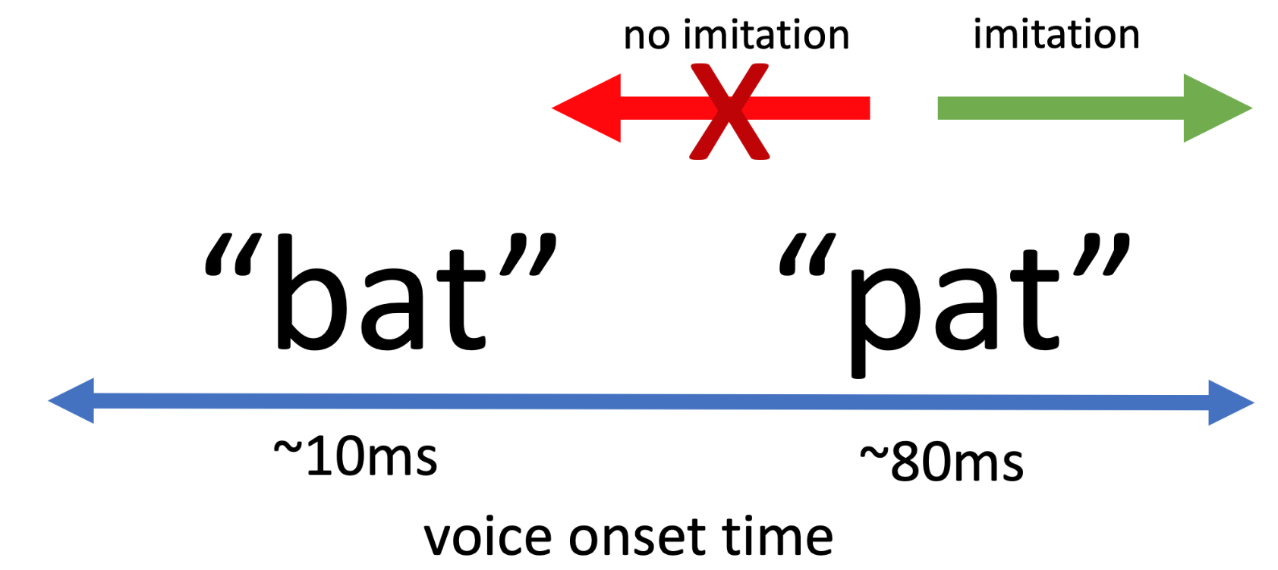
Contrast blocks convergence?

Slide 5
Contrast blocks convergence?
Robust imitation of enhanced VOT on English /p/
(Nielsen 2011; many others)

Slide 6
Contrast blocks convergence?
Mixed results on reduced /p/; interpreted as blocked by contrast with /b/
(Nielsen 2011)
Robust imitation of enhanced VOT on English /p/
(Nielsen 2011; many others)

Slide 7
But: Clear speech confounded with contrast
Imitating reduced /p/ requires hypoarticulation
not clear speech
clear speech
Imitating enhanced /p/ constitutes clear speech, default in lab settings

Slide 8
Main question: Does phonological contrast or clear speech constrain convergence?
i.e. Do people spontaneously imitate hypoarticulation in a lab setting?

Slide 9
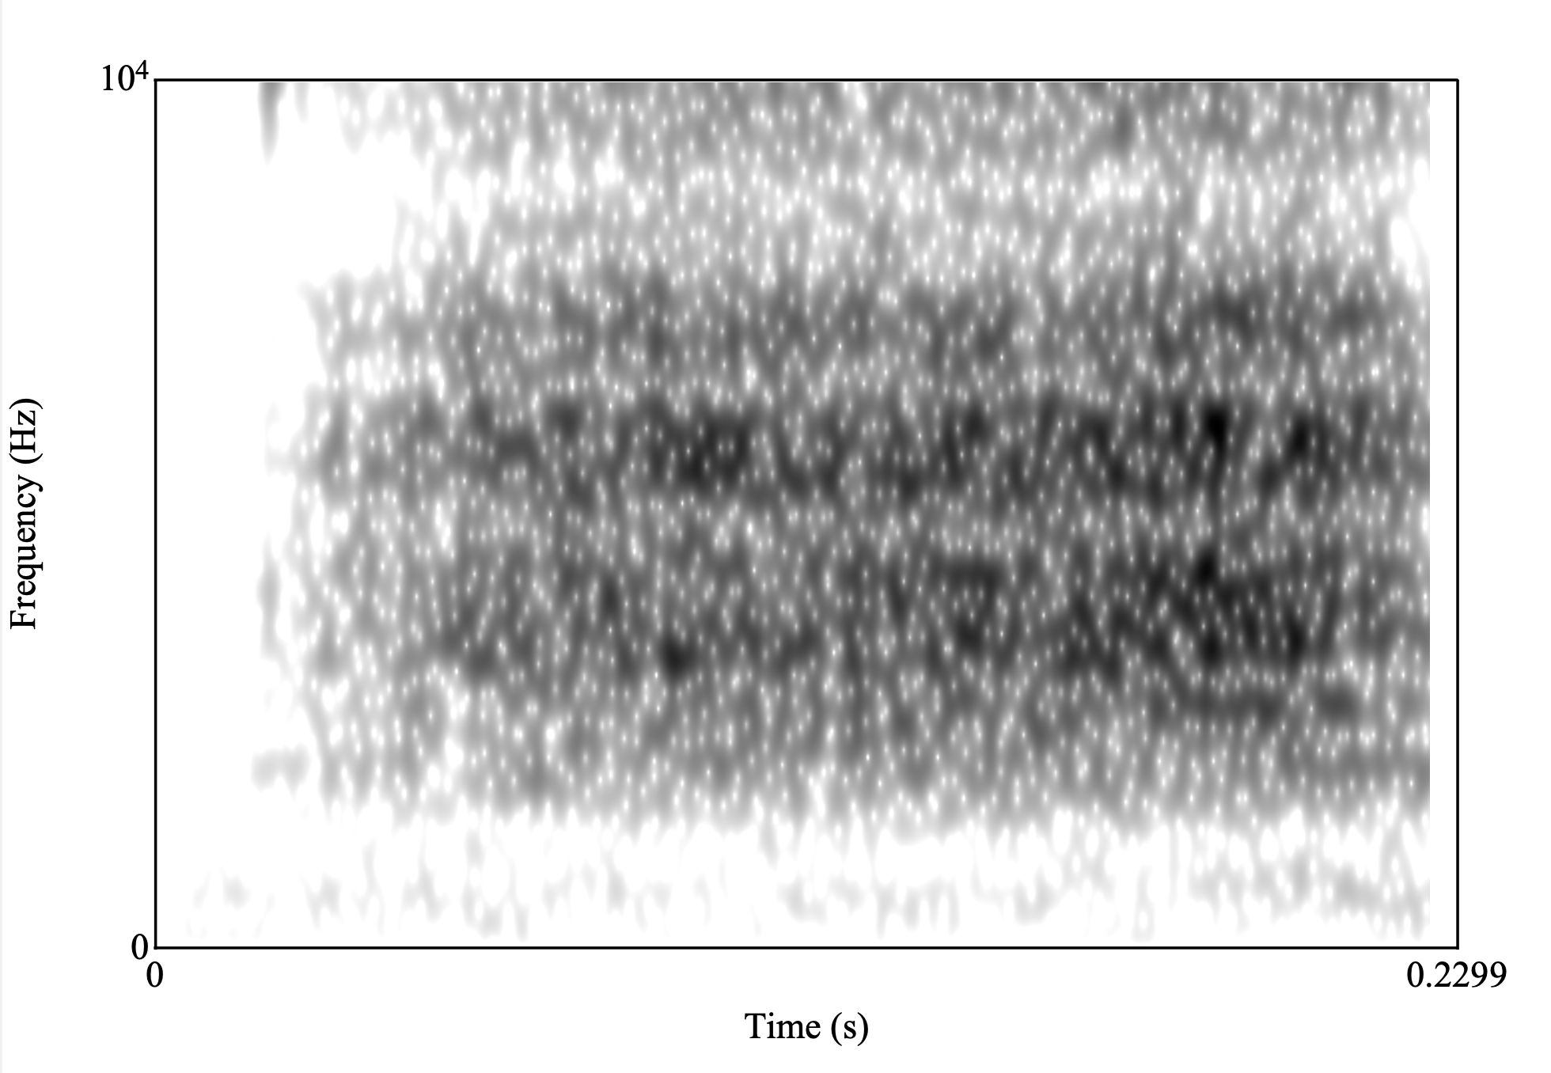
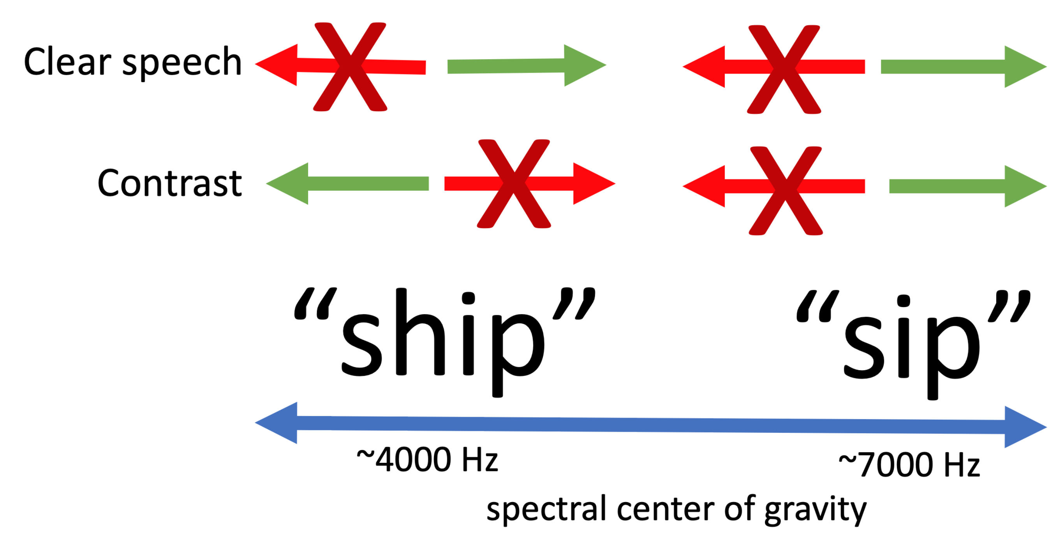

Sibilants de-couple clear speech and contrast
(CoG)

Slide 10
Sibilants de-couple clear speech and contrast
Imitation can be blocked by phonological contrast boundary (Nielsen, 2011)
constraint
(CoG)

Slide 11
Sibilants de-couple clear speech and contrast
English speakers enhance frequency of /s ʃ/ when speaking clearly (Maniwa et al., 2009)
constraint
constraint
(CoG)

Slide 12
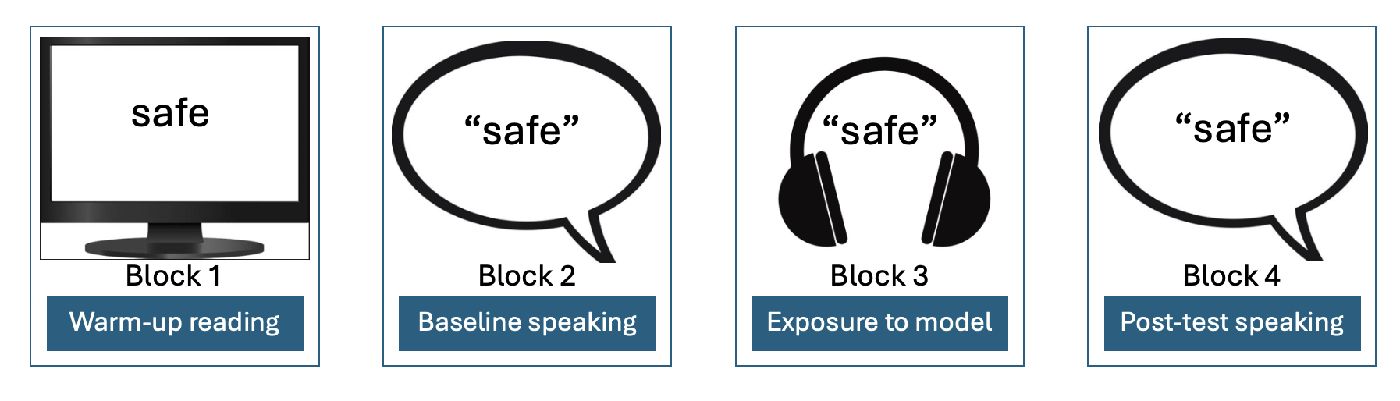
Experimental study: delayed shadowing

Slide 13
Exposure stimuli
80 /s/ or /ʃ/ initial words
  All had initial stress and no onset clusters
  Balanced for phonological neighborhood density, vowel rounding, and lexical frequency.
40 sonorant-initial fillers
Recorded by female L1 American English talker

Slide 14
Participants
60 monolingual English speakers (more bilingual/L2 not reported here)
  37 female, 19 male, 1 genderqueer, 3 non-binary
Between-subjects design – each person exposed to one of:
  enhanced /s/
  reduced /s/
  enhanced /ʃ/
  reduced /ʃ/

Slide 15
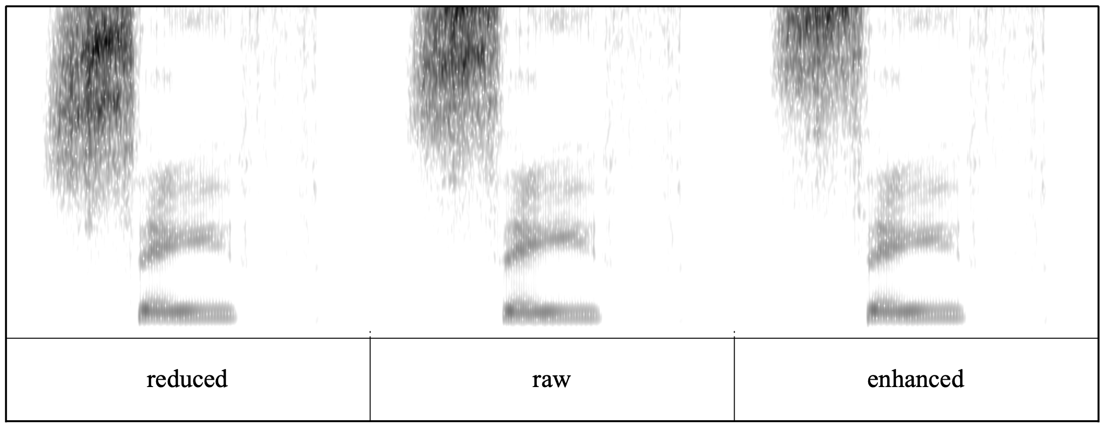
Exposure stimuli manipulation
avg 7,751 Hz
avg 8,938 Hz
avg 10,430 Hz
All words normalized for pitch and amplitude.
Shift frequencies function in Praat to enhance or reduce CoG by 15%

Slide 16
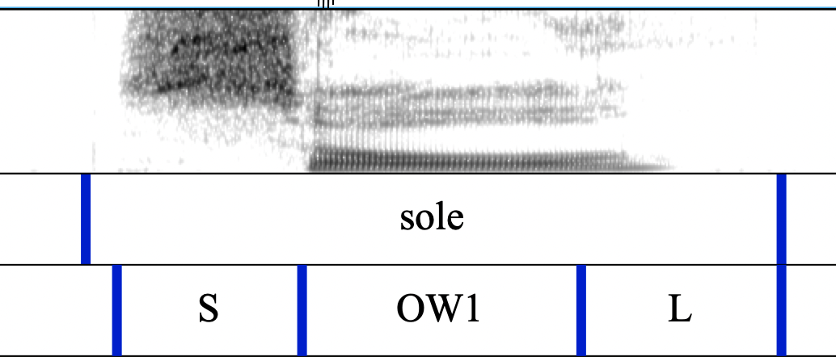
Data processing
  Forced alignment (McAuliffe et al., 2017) with hand-edited sibilant boundaries
  CoG calculated from time-averaged spectrum of middle 80% of sibilant
  Frequencies below 1000 Hz filtered out

Slide 17
Control results: /s/ convergence

Slide 18
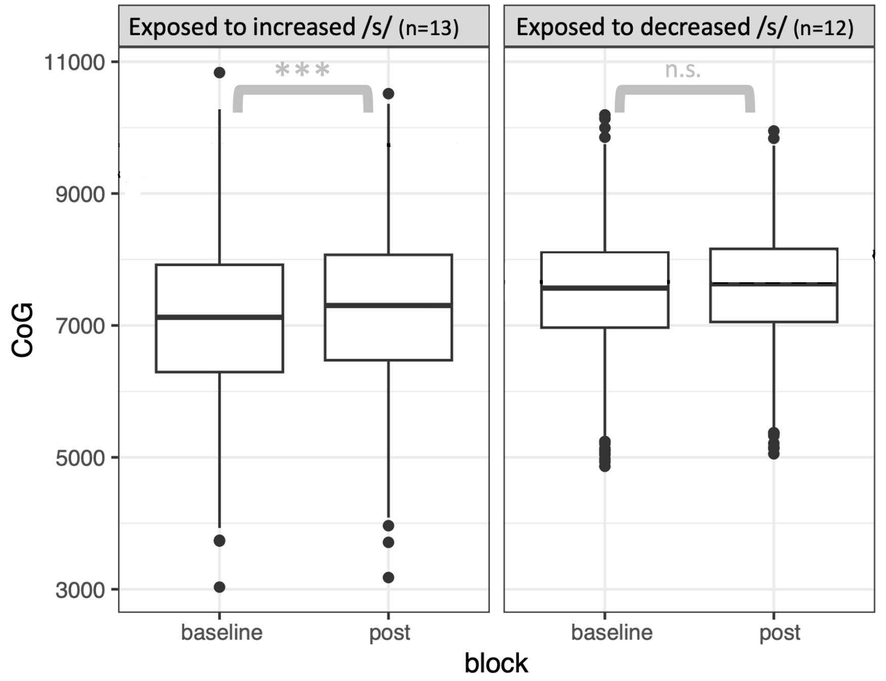
Control results: /s/ convergence
Significant increase in CoG after exposure to enhanced /s/
Consistent with both hypotheses

Slide 19
Control results: /s/ convergence
Significant increase in CoG after exposure to enhanced /s/
Consistent with both hypotheses
No significant increase in CoG after exposure to reduced /s/
(but significant convergence for most individuals)
Consistent with both hypotheses

Slide 20

Control results: /s/ convergence

Slide 21
Key results: /ʃ/ convergence

Slide 22
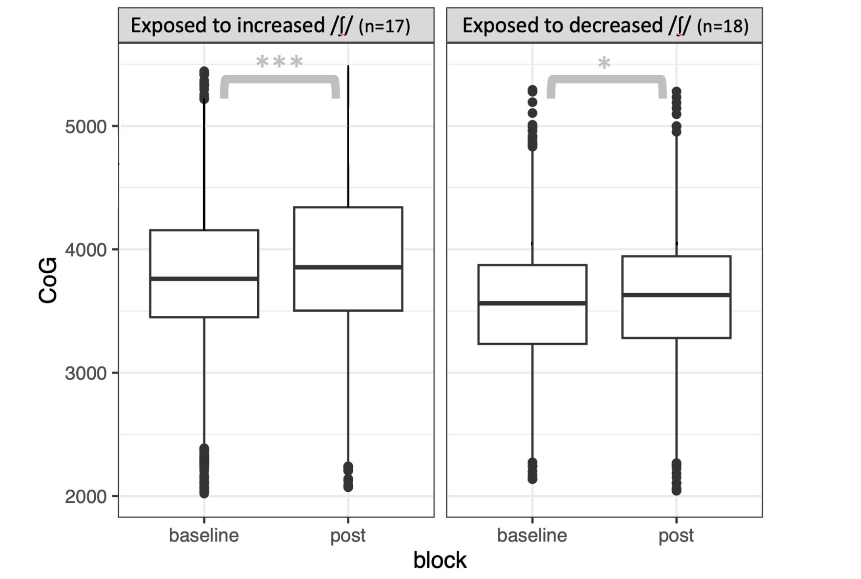
Key results: /ʃ/ convergence
Significant increase in CoG after exposure to enhanced /ʃ/
Consistent with clear speech constraint on convergence
Not consistent with contrast constraint

Slide 23
Key results: /ʃ/ convergence
Significant increase in CoG after exposure to enhanced /ʃ/
Consistent with clear speech constraint on convergence
Not consistent with contrast constraint
Significant increase in CoG after exposure to enhanced /ʃ/
Not fully predicted by either, but definitely not consistent with contrast constraint

Slide 24
Main question: Does phonological contrast or clear speech constrain convergence?
Finding: Clear speech
i.e. Do people spontaneously imitate hypoarticulation in a lab setting?
Finding: Not consistently

Slide 25
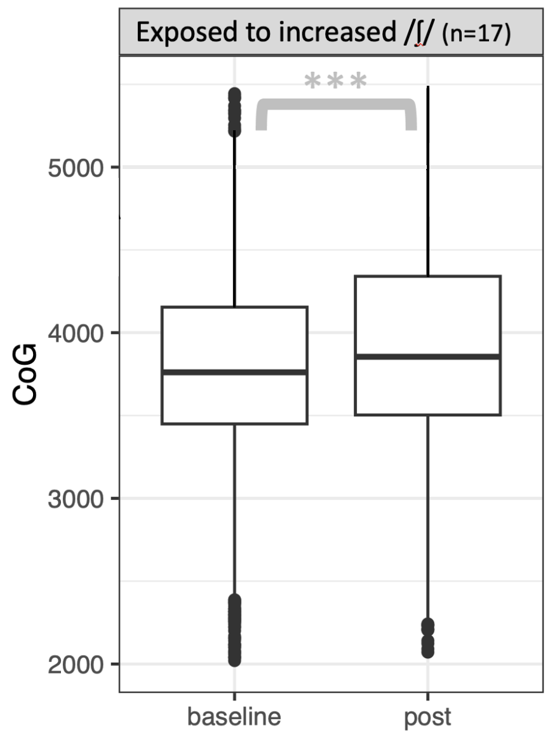
Contrast does not always constrain convergence
Key result: Participants increased /ʃ/ CoG despite boundary with /s/ to mirror enhanced model speech.

Slide 26
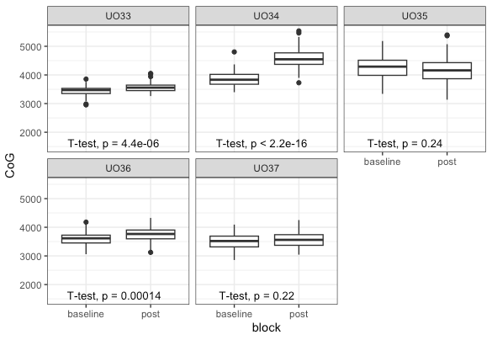
Enhancement more robustly imitated overall
Example individuals from enhanced /ʃ/ condition
Less imitation for reduced stimuli across all conditions
More individual differences for reduced stimuli

Slide 27
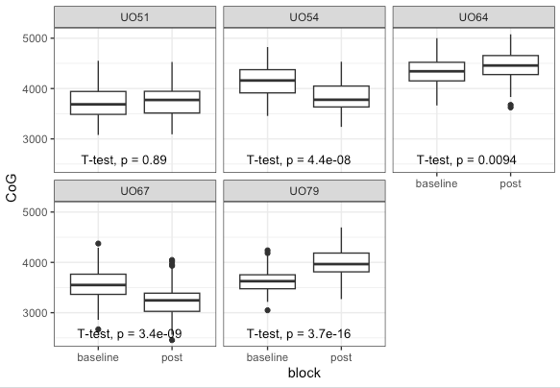
Enhancement more robustly imitated overall
Example individuals from reduced /ʃ/ condition
Less imitation for reduced stimuli across all conditions
More individual differences for reduced stimuli

Slide 28
Conclusions
Phonological contrast does not always constrain imitation
People do not consistently imitate hypoarticulation in a lab setting
Enhancement / clear speech more robustly and consistently imitated overall

Slide 29
Implications and future directions
Theoretical: Convergence may not be as linguistically sensitive as previously thought
  Potential clear speech benefit in imitation – why? (perception, lab setting, etc)
Methodological: Planning lab studies of convergence/imitation
Applied: Use of imitation in L2 learning and clinical speech therapy settings

Slide 30

Thanks!
Acknowledgements
collaborator Dr. Melissa Baese-Berk (Chicago) and the Speech Perception and Production Lab (Oregon) for assistance with data collection
members of the UTA Speech Sounds Lab and the phonetics/phonology reading group, including Danielle Quaye
reviewers at JASA and audiences at ASA and ICPhS
blog.uta.edu/hauseri/presentations
For references, slides, relevant JASA paper

Slide 31
The manipulation is perceptible
Multiple perceptual cues that stimuli are high/low for the model:
Vowel transitions were not manipulated and present a mismatch
Enhanced stimuli are well above typical range for female adult
Decreased stimuli mismatch with model’s higher-than-average fundamental and format frequencies
“cease” reduced
“cease” enhanced

Slide 32
Participants: Monolingual English L1 speakers
Four between-subjects conditions (total n=60)
13 exposed to enhanced CoG on /s/
12 exposed to reduced CoG on /s/
17 exposed to enhanced CoG on /ʃ/
18 exposed to reduced CoG on /ʃ/

Slide 33
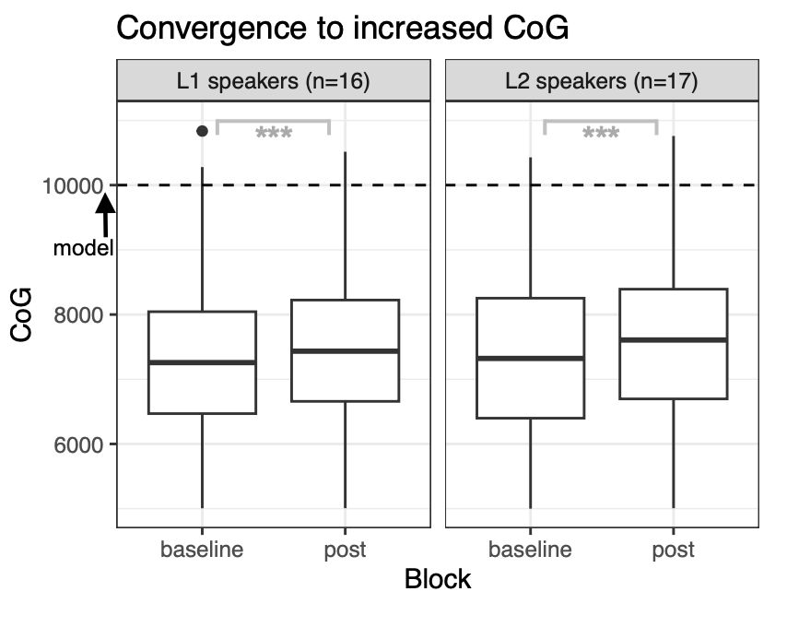

Slide 34
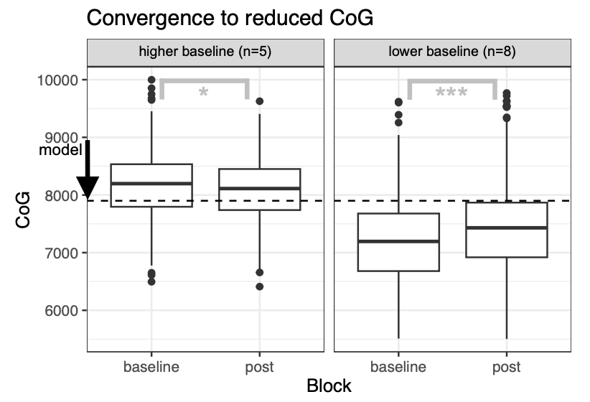

Slide 35
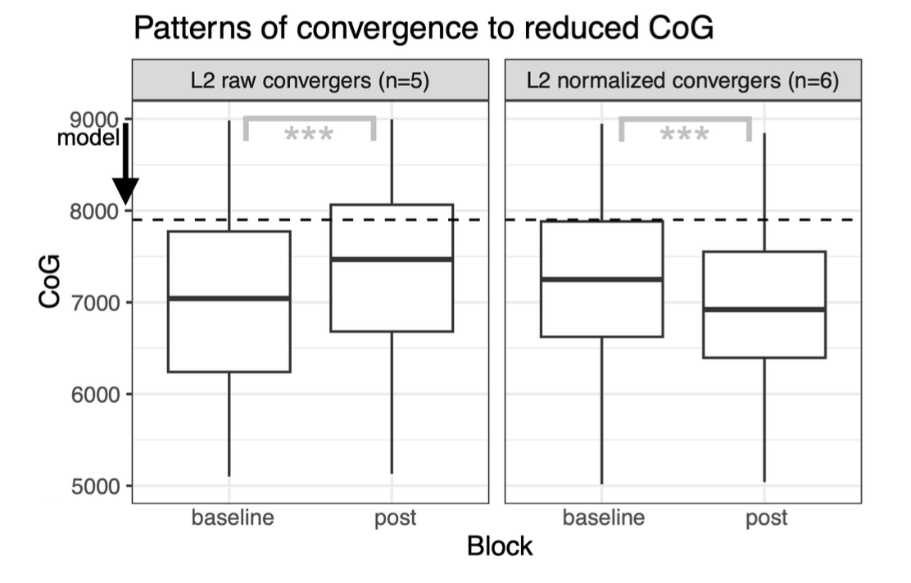

Slide 36
