Slide 1
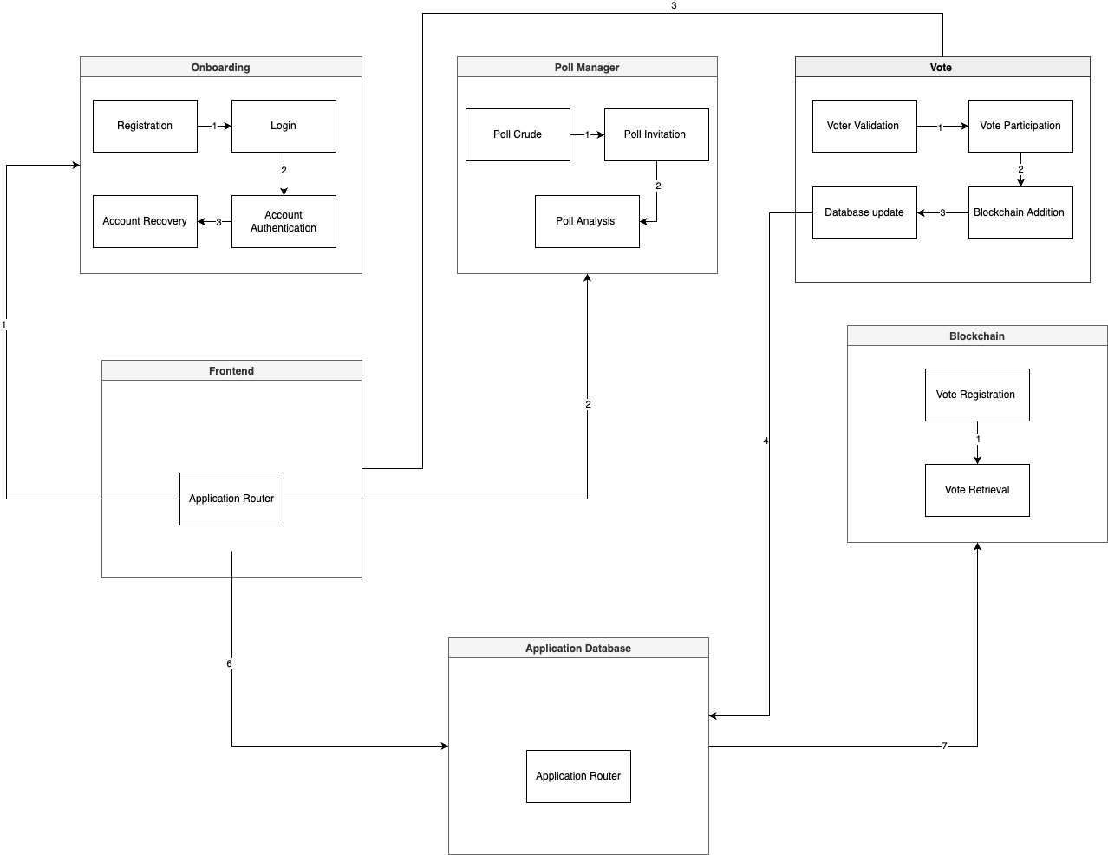
Blockchain Voting
Harun, A., Rodgers, S., Sakallah, A., Egbuta, K
CSE Senior Design
Background
Architecture Overview
Technologies
We chose blockchain voting as a project as we thought it solves a relevant problem in our current world.
Blockchain voting allows you to keep a ledger on the blockchain of any election, not allowing for any fraud or foul play of any kind. It keeps the election 100% transparent, visible to all parties, and doesn’t allow for any conflicts of interests.
On a broader scale, something like this could be used on the political level one day, but also has much smaller scale use cases as well.
High level architecture overview
Conclusions
The design was able to match the major goals, specifications, and constraints we set out for it. We wanted to create a decentralized polling app for people who were concerned about rigged polls and we were able to successfully create that.
Goals & Requirements
Design Specifications
Create accounts with admin and user permissions
Create polls with questions and choices
Invite users to polls
Allow users to vote in polls, log results on blockchain
Solidity for our blockchain library and smart contracts
Local SQL database for managing users and storing voting info
Storing votes both in our database and on the blockchain, using the smart contacts to document and verify what we have stored in our DB
Axios library to connect our program to our database, allowing to easily define post and get endpoints to access and modify our database
Lessons Learned
Ensure roles and responsibilities are delegated
Hold everyone accountable
Proper time management
Frequent communication
Future Plans
Widespread rollout of web app
Improve frontend design aspects
References
“Build a WEB3 app with Solidity + Ethereum Smart contracts,” buildspace. [Online]. Available: https://buildspace.so/p/build-solidity-web3-app/lessons/deploy-smart-contract-to-testnet. [Accessed: 01-Dec-2022].
“React axios tutorial – make HTTP GET and post requests.” [Online]. Available: https://www.positronx.io/react-axios-tutorial-make-http-get-post-requests/. [Accessed: 01-Dec-2022].
Z. Saleem, “Interact with smart contracts via react and a node.js API,” LogRocket Blog, 28-Jan-2022. [Online]. Available: https://blog.logrocket.com/interacting-smart-contracts-via-nodejs-api/. [Accessed: 01-Dec-2022].
2022 UTA College of Engineering Innovation Day
December 2nd, 2022

