Slide 1
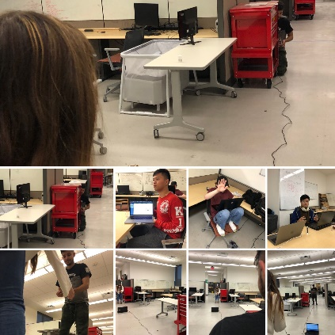
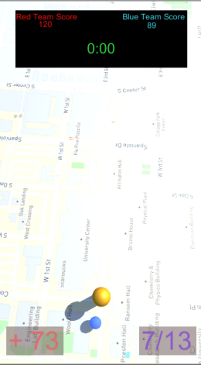
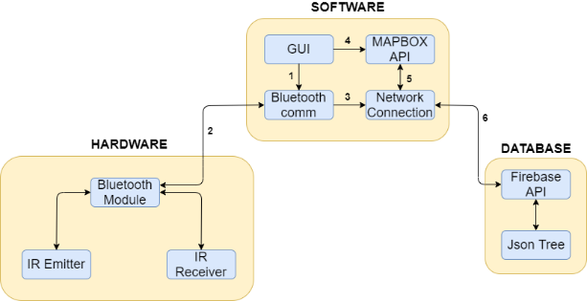
Lasers: Combat Evolved
Diptin Dahal, Jason Autry, Katarina Gomez, Phu Ly, Tausif Zaman
CSE Senior Design
Executive Summary
Conceptual Design Phase
Prototype & Test
Name | Description | Use
Username | What the user will be referred to as in the app | Input by user to identify each unique user
GPS Location | The location the user is currently at | Get, Display and Update from the user’s phone to be marked on the allies' maps
Map | The map of the play area | Requested from the map API based on user location
AR Map | The map with player positions | Compiled from the data input by the users and displayed onto the user’s phone
Pings | Places touched by the user on the map | Sent from the user’s phone to the server
Bullets | The signal from the laser gun | On user trigger pull sent from gun to user vest and includes shooter id
Lasers: Combat Evolved is aimed to create a fun and interactive laser tag mobile game without the restriction of router-based game play seen in other mobile laser tag games on the market. We plan to create an app that implements features such as, a Lobby for players to create a game or join a game, a live updating map to display where team-mates and possibly enemies in a real world setting, along with IR technology to create a working laser shooter and compatible sensor.
Background
Detailed Design Phase
Conclusions
Many ways to play laser tag exist. For example, at the local arcade Alley Cats, you can participate in a game of laser tag. There the arcade will supply you with a gun and vest combo to play the game but, you can only play in the designated arena and there is no map, so you don’t know where your allies are during the game. The cons of this is the lack of information and knowledge about your teammate’s where-about, which causes players to end up very frustrated.
Another option is you buy your own gun which would allow you to play anywhere you want, and some systems include a type of map feature, but the outcome of this is those devices have the restriction of requiring the players to be within a specific range around an included router to track the player’s position.
Those missing components are not the downside of the game play since laser tag itself is the game that family and friends would enjoy playing together. However, as technology grows beyond the eyes of humanity, we wanted to improve and bring the game play further to the point that players could overcome those missing components, we will achieve this by providing various of supports to ensure their game play will become more and more realistic.
The overall system will be similar to a Real-Time System where information will be updates after a certain amount of time. The system will consist of 3 main layers Database Layer, Android Application Layer, and the Hardware Layer. The basic strategy is letting them handle difference data processes as such Hardware Layer will be handle only signal data from any hardware devices and pass them on to the An-droid Application Layer. Using a certain implementation, these data will commute through a Bluetooth Module sub-layer within the Hardware layer that allow the Android Application Layer to request and receive data via Bluetooth signal. Lastly, Database Layer will receive information from Android Application Layer to control and process it for placement in the database. The processed data will then be sent to the database for storage until it is needed by the Android Application Layer. The relevant processed data will then be retrieved by Android Application Layer for display.
As of our first demo of our project, we believe we have followed the design specifications well. There have been some hurdles to face, such as which Map API we would be using, as well as deciding which Microcontroller would be best for our project, however from our specifications we established at the beginning of the project, we have completed most of them.
Name | Description | Source | Priority | Complete y/n
Custom Build System | A personalized system for this specific type of game application with interaction from both client server and main server | Customer Requirement | Critical | Pending
Separate Device – Application System | Hardware related devices are separated from the system application | Customer Requirement | Critical | Yes
Real-Time Map Features | Implements real-time map system on the user’s current location | Customer Requirement | Critical | Yes
Map Customization | Allow User to create their own play area boundaries | Customer Requirement | High | Pending
Custom Cloud Based | Using cloud-based system instead of the traditional router-based system | Customer Requirement | Critical | Yes
Communication | Allow user to communicate with other players/team-mates | Customer Requirements | Critical | Pending
References
Liu, S., and Bobrow, J. E., “An Analysis of a Pneumatic Servo System and Its Application to a Computer-Controlled Robot,” ASME Journal of Dynamic Systems, Measurement, and Control, 1988, Vol 110 pp 228-235.
Hasbro. Nerf Laser Ops Pro AlphaPoint, 2019.
JEM Accessories Inc. Xtreme Augmented Reality Blastert, 2017.
JEM Accessories Inc. Xtreme Augmented Reality Blastert, 2018.
Skyrocket Toys LLC. Recoil Laser Tag Starter Set, GPS enabled Multi-Player Smartphone Game,2017.

