Slide 1
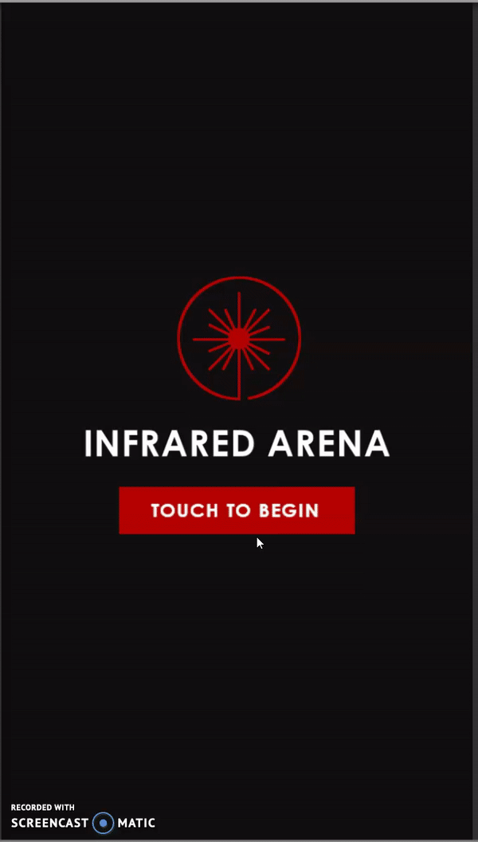
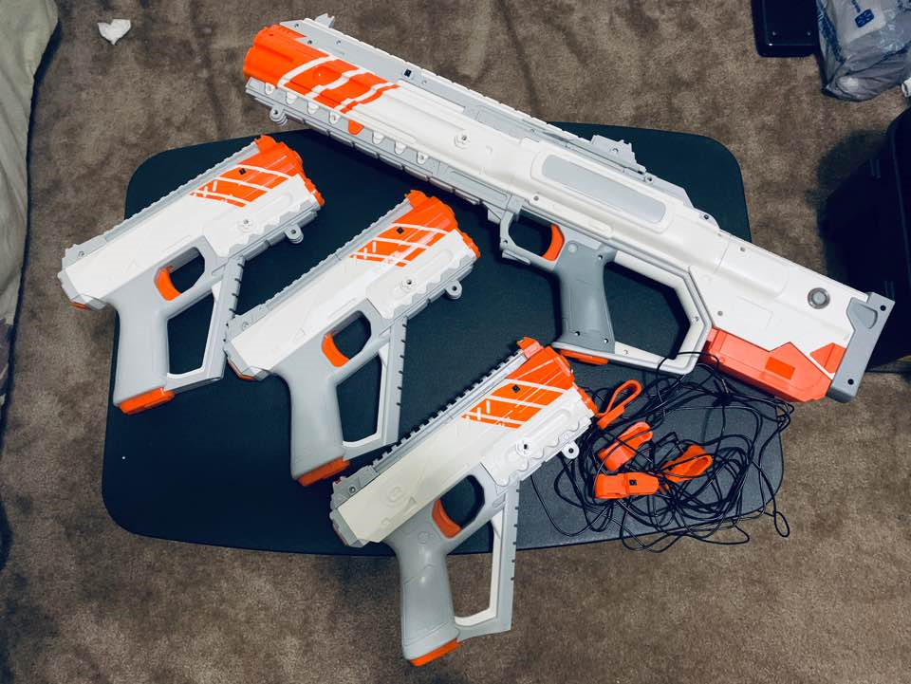
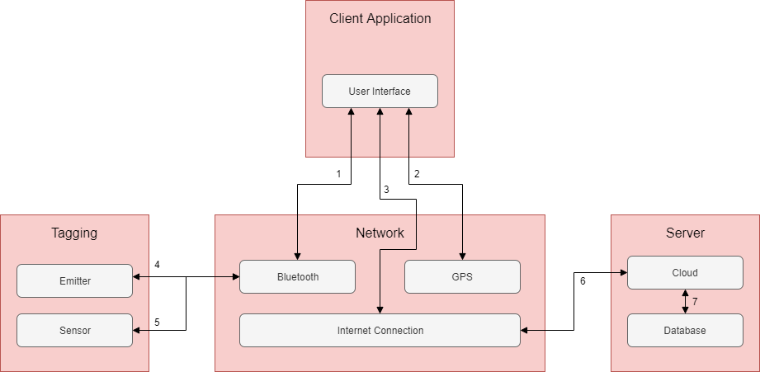
Team Infrared – Infrared Arena
Acevedo, Edgar., Batongmalaki, Justine., Phanvilay, Linda., Vu, Danny., Yacho, Jean-Marcel.
CSE Senior Design
Executive Summary
Conceptual Design Phase
Prototype & Test
Our objective is to develop a system that would reimagine the gameplay experience of the popular nostalgic game laser tag. We intend to build an application that would allow users to play on their mobile devices and host private matches with wider field coverage. The system is composed of a physical laser gun which we are attuning to our application and the mobile application. The application is being created in Unity. Our focus is software heavy and the application will utilize cloud services for multiplayer usage and be available for Android devices.
The system will consist of the user's mobile device, and a laser tag gun containing an emitter and sensors. The primary feature of the product is to leverage cloud services to allow end-users the ability to play laser tag through a mobile device. The application will be integrated with a modified version of the discontinued RECOIL laser tag system, where we intend to intercept the existing Bluetooth signal to connect our mobile devices to the laser tag gun. We will also improve their system by enhancing the UI experience, with a more robust mobile application. The RECOIL system was limited in that players all had to connect to one Wi-Fi access point in order to play together, our system will be a cloud-based system that allows players to join games over any internet connection.
Figure 2 shows the Recoil Kit guns that we are using in tandem with our application shown in Figure 3. Due to COVID-19, we have not implemented field testing at this time, but are testing the multiplayer functionality with multiple Android devices and tablets
Figure 2. RECOIL Equipment
Figure 3. Product Interface
Background
Detailed Design Phase
Conclusions
Our sponsor for this project is our senior design professor, Shawn Gieser. Gieser has given us this project to in hopes that we can create a next generation laser tag app. Similar products already exist, but our goal is to improve upon the products that are currently in market.
One growing phenomenon Americans have seen within the last decade, is the rise of eSports and popularity of multiplayer video games. However, on the other side, we find classic entertainment games such as laser tag falling behind. While technology has allowed game mechanics to improve and enhance game equipment and player experience, laser tag is ultimately often viewed as a service that is provided by laser tag centers and entertainment venues and is often not accessible everywhere. We aim to build an application that will enable users to play laser tag through their mobile devices anytime, anywhere. Its greater accessibility would encourage users to reconnect with one another, save costs from traveling, using facilities and equipment, and maintain physical activity.
The client layer, which includes the customers phone, is expected to include these dependencies: GPS, mobile internet connection, Bluetooth, and Wi-Fi. The client will be the host of our project, the application “Infrared Arena”. The tagging subsystem is comprised of the infrared laser and sensors on the blasters for targeting and sensing hits from other players. The software used is Bluetooth low energy which will allow connection between the laser guns and the client. The Network subsystem is the link between every other subsystem. Every bit of data is transferred to and from this subsystem. This data is collected in the cloud, received through transmissions from the Network layer and after processing, the data is stored in the Database that is managed by our cloud server.
We constructed our system's architecture to better visualize our system's layout of abstraction to another level of detail (Figure 1).
What we have accomplished is a completed user interface, pinging system for team communication, a real-world map to display to players using MapBox, connection between the Bluetooth in our app and the Recoil Gun, a cloud server using Firebase, and integration testing.
In the future, we hope to work on field testing of our product, further improvement of its features such as a large multiplayer connection, and release onto the Google Play Store.
References
1. Pointer Clicker. Recoil Laser Tag Review. https://pointerclicker.com/recoil-laser-tag-review/
2. Scientific American. How does Bluetooth work?, //www.scientificamerican.com/article/expertshow-does-bluetooth-work/
3. Recoil Open Resource Documentation, https://www.theworldisnowgame.com/open-source/
Figure 1. System Data Flow Diagram
Spring 2020 Senior Design Demo
May 15, 2020
Notes:
Executive Summary - This is a full scale template. Posters will be printed at 40” x 32”. Body text is set in Calibri and should be no smaller than 28 pt. As a Senior Design team, start here with your executive summary. Notice that the content in the poster flows down by column, then over to the next column. This template is set up to mirror the steps of the engineering design process, though you may make adjustments as relevant to your project.
Background - High-level need as conveyed by the client. Even if your project calls for solving a very narrow, well-defined technical need, highlight its importance in some broader societal context. This is also a good place for reference info, prior art, statistical facts, expert quotes, etc. that justify why this is a problem worth solving.
Conceptual Design Phase - If the classical steps of the engineering design process apply, this would be a good place holder for your specifications, constraints, initial analyses, conceptual design efforts, and down-select justification.
Detailed Design Phase - Default placeholder to share detailed technical information on your chosen concept. Describe core technologies, what makes your solution unique, important tradeoffs, and supporting detailed analyses. Be generous with visuals to help draw attention to and better illustrate your work.
Prototype & Test - Default placeholder for your prototyping and test results. Prototyping can be interpreted in a broad sense—not only hardware, but high-fidelity simulations.
Conclusions - Assessment of how well your chosen design matched the client’s original goals, specifications and constraints. Highlight insights, lessons learned, future plans, etc. Acknowledge your client, sponsors, and other sources of support towards your work.
References - Liu, S., and Bobrow, J. E., “An Analysis of a Pneumatic Servo System and Its Application to a Computer-Controlled Robot,” ASME Journal of Dynamic Systems, Measurement, and Control, 1988, Vol 110 pp 228-235.

